Slide 1
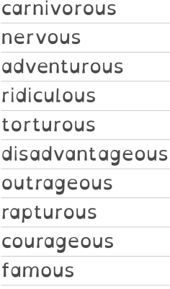
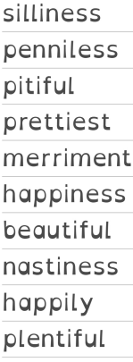
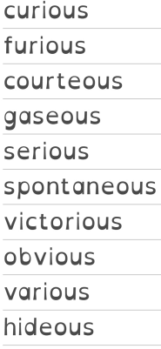
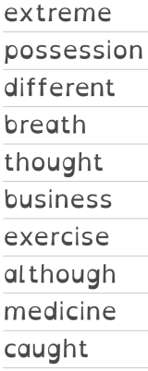
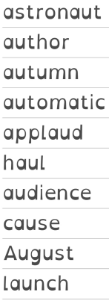
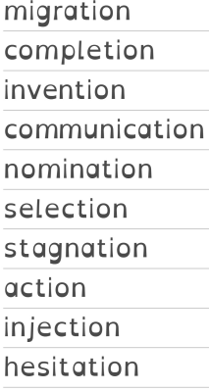
Week 1 (w/c 5 Jan) Words ending in -ous | Week 2 (w/c 12 Jan) Words where a suffix is added to a word ending in y | Week 3 (w/c 19 Jan) Words ending in –ious and -eous | Week 4 (w/c 26 Jan) Challenge words | Week 5 (w/c 2 Feb) Words where ‘au’ makes an /or/ sound | Week 6 (w/c 9 Feb) Words ending in -tion

